Slide 1

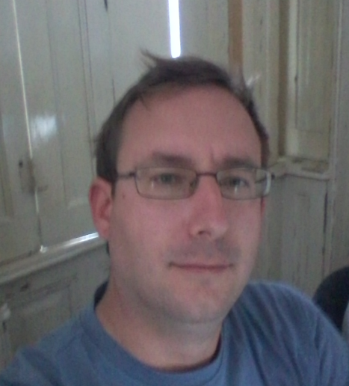
Péter JOLÁNKAI
2nd DEMO
13.10.2017
Pallida Cohort - Static Clas
Hardware programing

Slide 2
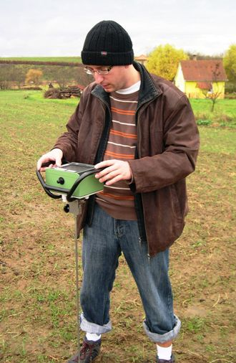
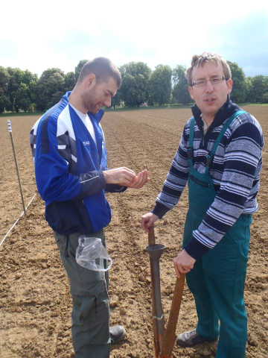
Introduction:
I am an agronomist, with university research background
and lecturing

Slide 3
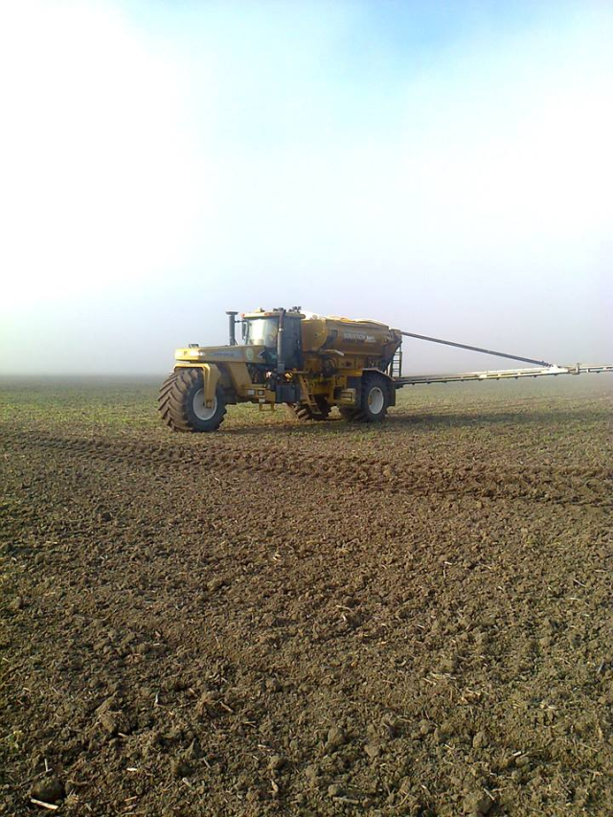

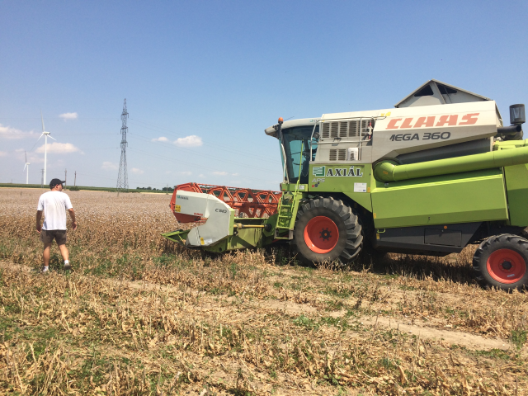
Later I worked for a company
as an agronomist
for producing medical plants

Slide 4

And now I am in a boot camp learning for junior
Hardware programmer at the Green fox Academy.

Slide 5

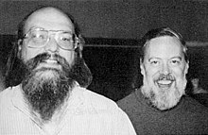
Last week we started the basics of C language

Slide 6
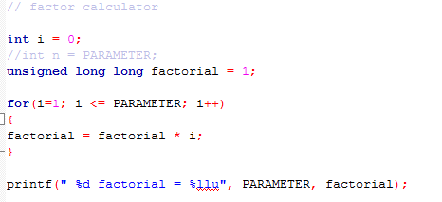

Slide 7
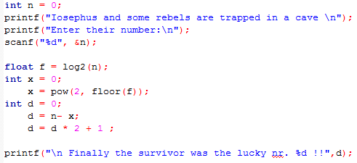

Slide 8

Thank you for your attention!

